Slide 1
Design and Simulation of a Smart Home Security System using Half Adder and Logic gates
SMART HOME SECURITY SYSTEM
PRESENTED BY BATCH : 11
HARSHINI - 2620040066
JASMITHA - 2620040033
HARSHITH - 2620040115
LOHITH - 2620040023

Slide 2
Introduction and Objective
FOUNDATION
What problem are we modelling, and what should the circuit do?
Introduction
Output and Rule
Sensor Inputs
A home can have several possible entry points. Door, window, and motion sensors provide simple ON/OFF signals. Digital logic combines these signals to decide whether a possible intrusion should trigger an alarm.
Alarm output: 1 = alarm ON; 0 = alarm OFF. The alarm sounds only when the system is armed and the selected security condition is satisfied.
Door (D)
1 = open; 0 = closed
Window (W)
1 = open; 0 = closed
Motion (M)
1 = movement detected; 0 = no movement
Project Objective
Control Inputs
Build a digital circuit that counts active sensors, applies one of two security rules, and blocks the alarm whenever the system is disarmed.
Logic convention: A logic value of 1 means ON/active and a logic value of 0 means OFF/inactive throughout this project.
Arming Switch
1 = security ON; 0 = OFF
Mode Selector
0 = normal mode; 1 = strict mode

Slide 3
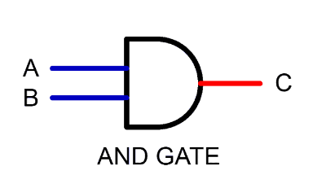
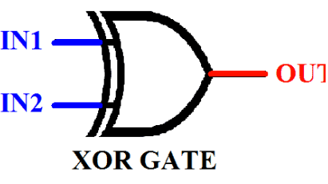
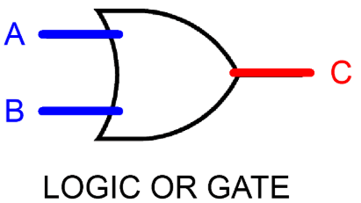
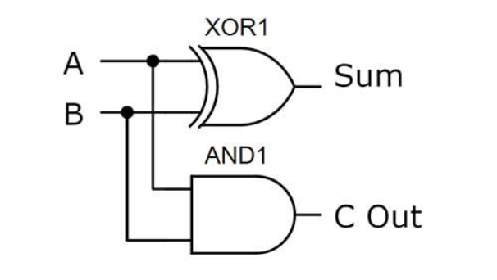
Theory and Logic Circuit
LOGIC MODEL
How the sensor counter and security decision work
1. Half-Adder 1 — Inputs: Door (D) and Window (W)
Output | Expression | Meaning
Sum₁ | D XOR W | 1 when inputs differ
Carry₁ | D AND W | 1 when both are 1
2. Half-Adder 2 — Inputs: Sum₁ and Motion (M)
Output | Expression | Meaning
CountLow | Sum₁ XOR M | Low bit of sensor count
Carry₂ | Sum₁ AND M | Second carry signal
3. OR Gate — Count High Bit
Circuit Diagram Placeholder
CountHigh = Carry₁ OR Carry₂
Half-Adder 1 Half-Adder 2 OR Gate AND Gate
The two bits together count active sensors from 0 to 3:

Slide 4
Circuit Design in Logisim
IMPLEMENTATION
Implementation, signal path, and Boolean expression
Boolean Expressions
Signal Path
Signal | Expression
CountLow | (D XOR W) XOR M
CountHigh | (D AND W) OR ((D XOR W) AND M)
Normal condition | CountHigh OR CountLow
Strict condition | CountHigh
Selected alarm | MUX(Normal, Strict, Mode)
Alarm | Armed AND Selected alarm
01
Sensor Inputs
Door, window, and motion inputs enter the circuit
02
Half-Adder 1
D + W → produces Sum₁ and Carry₁
03
Half-Adder 2
Sum₁ + M → produces CountLow and Carry₂
04
OR Gate
Combines Carry₁ and Carry₂ to form CountHigh
05
Multiplexer
Selects normal or strict rule based on Mode selector
Select = 0 chooses normal mode; Select = 1 chooses strict mode. The selector does not arm the system.
06
AND Gate
Combines selected signal with Armed switch
07
Alarm Output
Final 1-bit alarm result

Slide 5
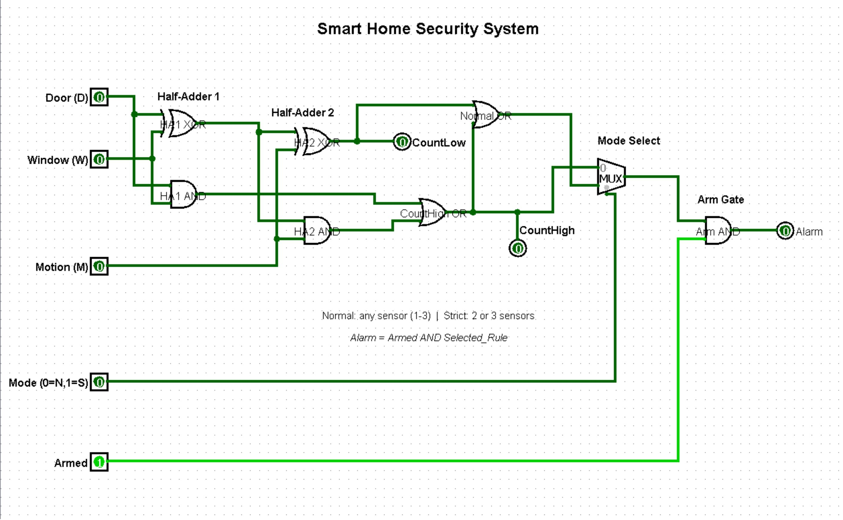

Slide 6
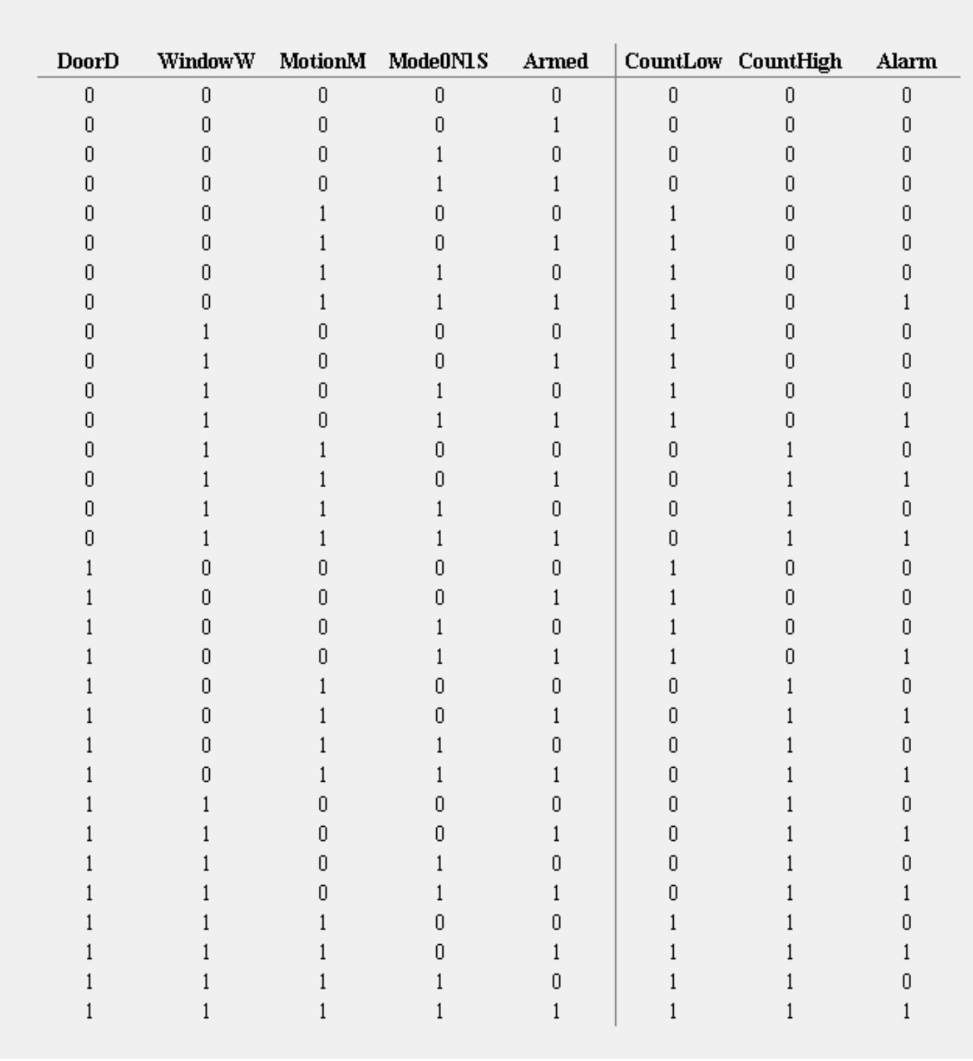

Slide 7
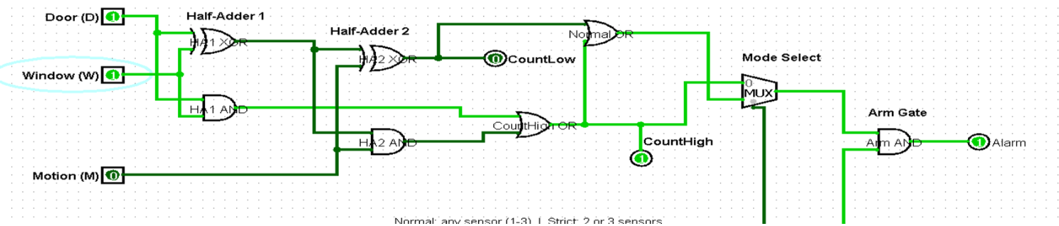
Simulation Results
VERIFICATION
Truth Table — Sensor Count vs. Mode
How to Test
Active Sensors | Count (High, Low) | Normal Mode | Strict Mode
None | 0 0 | OFF | OFF
One sensor | 0 1 | ON | OFF
Two sensors | 1 0 | ON | ON
Three sensors | 1 1 | ON | ON
1
Arm the System
Set Armed = 1 to test alarm responses
2
Change Mode
Mode = 0 for normal; Mode = 1 for strict
3
Disarm Test
With Armed = 0, alarm is OFF for every sensor combination
Normal mode triggers for 1, 2, or 3 active sensors. Strict mode triggers only for 2 or 3 active sensors.
4
Troubleshoot
If output differs, check the MUX select pin, sensor inputs, and arming switch
Truth Table / Extra Test Evidence Placeholder
Insert your full truth table or additional Logisim screenshots here. Include the three sensor inputs, mode selection, arming switch, and expected alarm output.

Slide 8



Conclusion and Applications
CLOSE
Conclusion
Applications
Possible Improvements
Sensors represent doors, windows, and movement in a protected area.
Half-adders count the active sensors; the OR gate combines carry signals.
The multiplexer selects normal or strict mode.
The final AND gate ensures the alarm only works when armed.
The project demonstrates half-adders, XOR, OR, AND, and multiplexer logic in one design.
Homes & Apartments
Siren / Notification Output
Add a real siren or notification output for physical alerting
Laboratories & Offices
More Sensors
Include additional sensor inputs to cover more entry points
Small Storage Rooms
The same logic concept can be adapted to other protected areas.
Delay or Entry Code
Add a delay timer or PIN-based entry code for usability
Limitation
This is a digital logic simulation, not a complete real alarm. A real installation also needs physical sensors, power, a siren driver, and safe installation.
Real Hardware
Test the circuit with real hardware after safe design review

